Slide 1
CS4499/5599: Data Science and Applied Machine Learning
Class Lecture: January 11th, 2023

Slide 2
Objectives
Discuss why we learn data science
Python refresher
Assign Homework 1

Slide 3
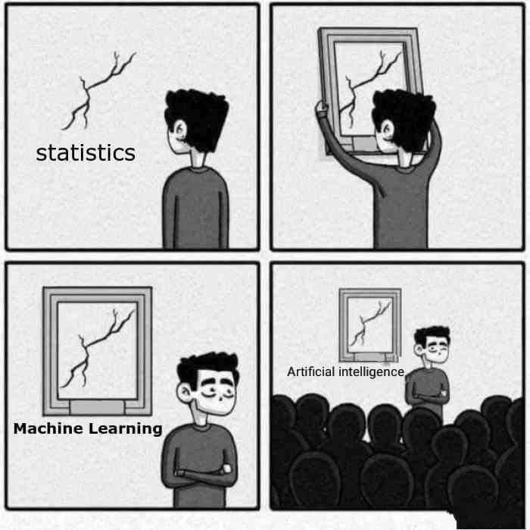
What is Data Science?

Slide 4
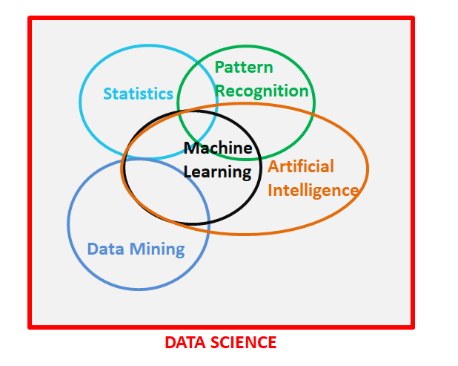
What is Data Science?

Slide 5
Why Learn Data Science?
In the field of computer science, machine learning, A.I, etc. are areas which are growing at very fast rate.
The U.S. Bureau of Labor Statistics reported that the average salary of a data scientist is over 100,000 USD per year, including a high salary for entry level professionals.
Despite a recent influx of new workers in the field demand continues to outpace supply.

Slide 6
Why Learn Data Science?
Why is there such a high demand for data science skills?
The short answer is efficiency and performance.
In the current environment there are a number of factors that are influencing this:
Globalization
Inflation & economic concerns
Improve computational capabilities
A desire for more automation
A desire for more customization

Slide 7
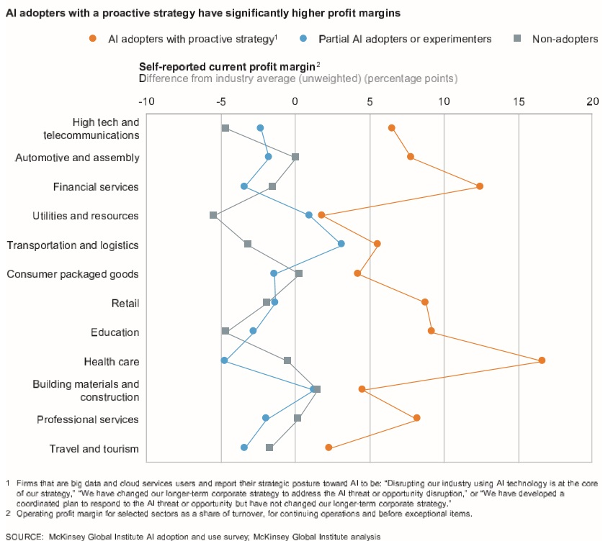
Why Learn Data Science?

Slide 8
Python
In this class we will be using Python for all in class examples, homework, etc.
Python is a high-level programming language, that was initially developed in the early 90’s
Python use began to really take off in the 2000s with the release of Python 2.0
Today all new Python code uses version 3.0

Slide 9
Python Vs. Other Languages
Python like C/C++, Java, etc. is an object-oriented (or class based) language
Python was designed to be easy to use and learn, so many of the requirements of lower-level languages aren’t needed
Python is a dynamic language, so type declaration, semi-colon line breaks, etc. are not used
Instead of compiling code into an executable file such as a .exe or .class file, Python files (.py) are sent to an interpreter to run

Slide 10
Python Vs. Other Languages
While Python is easier to use for most programmers, it does have some drawbacks
The most significant is speed. Both C++ and Java are much faster than Python.
C++ also makes better use of memory management so if your program will be interfacing with hardware a lot that is a better choice
However, for data science Python is one of the best choices

Slide 11
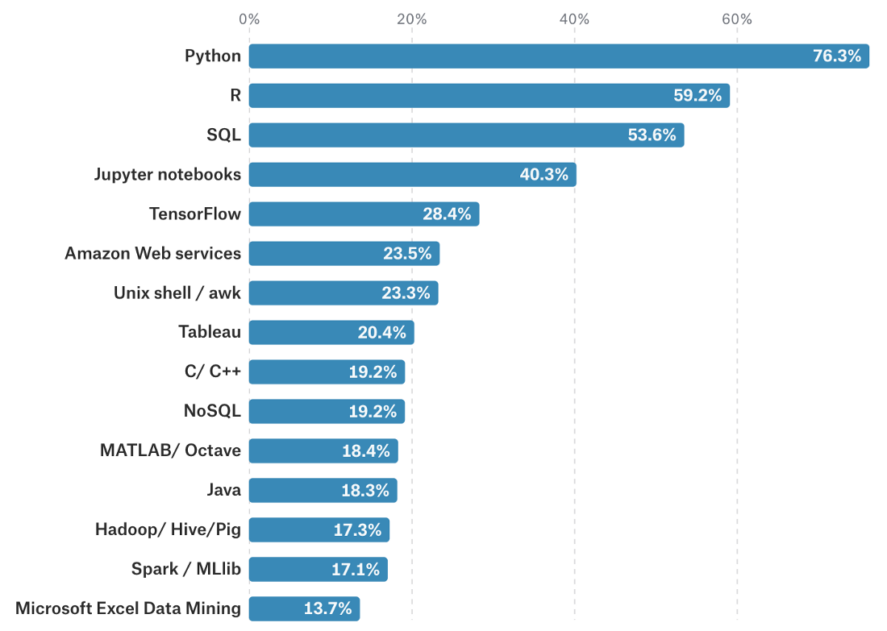
Python Vs. Other Languages
Source: Kaggle Survey Results for most used Data Science Tools

Slide 12
Python Basics
To get you ready for this class (and your first homework) lets open a Colab notebook and try some Python basics:
Comments and Text
Variable declaration and print statements
Conditional Statements
Loops
Functions
Classes

Slide 13
For Next Time
Next time in class we will begin going over:
Data structures in Python
NumPy package
Pandas (if time permits)
Homework 1 is up on Moodle and is due on 1/18 before class
Tips for homework:
Unless otherwise told you only need to turn in your notebook
Always run everything in your notebook before you turn it in. Remember if it doesn’t run the grader cannot give you credit.

